Slide 1
Representing the Game World
Pathfinding is carried out by means of a pathfinding graph
  Nodes, connections, and costs
Games are not made of these
  Need to be able to translate between the two
We therefore need to split the game world into regions that are linked

Slide 2
Generation
Automatic
  Easiest
  Tilegraphs, Points of Visibility or Navigational Polygon Meshes
Manual
  Best Results (can be easily tuned)
Translation
  Conversion of a node to real world coordinates is called localization
  Conversion of real-world coordinates to a node is called quantization

Slide 3
Division Scheme
To do pathfinding, we divide the space into regions and connections.
A division scheme is Valid
  If all points in two connected regions can be reached from each other (because the graph doesn’t mislead!)
Most schemes do not enforce validity
  At least not fully!
We should understand the validity properties of the graphs produced by the major division schemes...

Slide 4
Division Schemes
The major division schemes:
Tile Graphs
Points of Visibility
Polygonal Meshes
Dirichlet Domains

Slide 5
1 - Tile Graphs
Tile-based 2D isometric graphics are dead
  Long live the Tile
Division Scheme
  Grid can be turned into a tile based graph.
  Nodes in the pathfinder’s graph represent tiles in the game world
  Connections between nodes connect to their immediate neighbours
Localisation and Quantization
  Can map any point in the world to a specific tile (fast)
  Square grid is the easiest:
    tileX = floor( x / tileSize);
    tiley = floor( y / tileSize);
  Use the centre point of a tile to convert a node back into the game

Slide 6
1 - Tile Graphs
Generation (automatic)
  Because they are so simple they can be generated at run-time
  No need to store connections. Can be generated as needed by the pathfinder
Validity
  If each tile is either completely blocked (occupied) or completely free then the graph is valid
  Partially blocked tiles may result in an invalid graph

Slide 7
1 - Tile Graphs
Usefulness
  There can be large numbers of tiles in a level. Lots of work for search algorithm.
  Paths can also appear blocky. Need to be smoothed out.
    See later
  Could add costs associated with moving from tile to tile
    e.g. moving up/down a gradient
    Maintain a grid map of height values
    Cost then based on distance between tiles and change in height between tiles

Slide 8
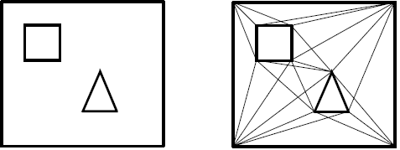
2 - Points of Visibility
The optimal path through a 2d environment will always have inflection points
  We can use these as graph nodes (typically the shortest path anyway)
Move nodes out from obstacles
  to allow for smoother movement
Raycast between points to identify connections
  Only if we don’t hit any obstacles
Quantization: Find closest point (centre of Polygon?)
Localization: node is a RW location!
Graphs can be generated automatically
Lots of points and edges may be generated (e.g. a large cavern)
  need to be pruned! (manually)
  may not be worth the effort
2D Visibility Playground

Slide 9
3 - Polygonal Meshes
The humble polygon
Level consists of polygons
  usually triangles (may be quads)
  but should be convex
  artist labels polygons as floor, wall, ceiling etc.
Each polygon is considered a node
Adjoining polygons are connected by edges
  Nodes connected if their polygons share an edge
Graph is based on mesh geometry
  Navigation mesh or “navmesh”
Notes:
See “Programming Game AI by Example” - Buckland

Slide 10
3 - Polygonal Meshes
Localization: Any point in polygon
  but normally the geometric centre
Quantization: The Polygon containing point
  but finding it can take time
  Could use coherence assumption
    Search polygons nearest last known position
Edges as nodes?
Some polygons cannot contain players/NPCs
  too small, too near obstacles
  need to prune

Slide 11
3 - Polygonal Meshes
Very popular technique
  Especially for different geometries such as planning routes up walls, across ceilings e.g. spiders
  NPCs can go anywhere in a cell (convex)
    NPCs not limited to moving to nearest waypoint
  NPCs of different sizes can use the same waypoint network
  All major game engines provide Navmeshes

Slide 12
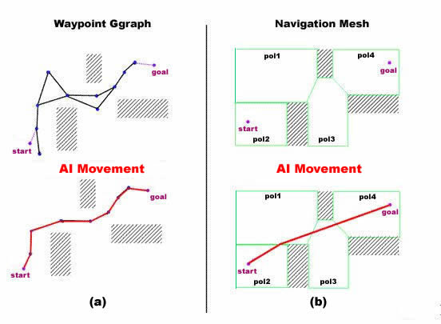
Compararison

Slide 13
Example from World of Warcraft
Navigation using waypoints vs Navigation on a NavMesh

Slide 14
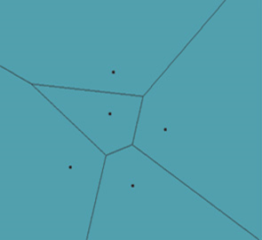
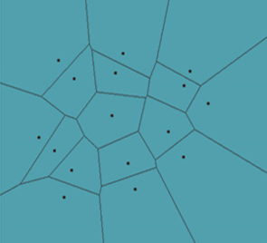
4 - Dirichlet Domains
Johann Peter Gustav Lejeune Dirichlet (1805–1822)
Also known as Voronoi Polygons in 2D
  Georgy Voronoy (1868 – 1908)
Describes the spatial relationship between points
Region around one of a finite set of source points whose interior consists of everywhere that is closer to that point than any other point
Each domain has a characteristic point
Connections are placed between neighboring domains

Slide 15
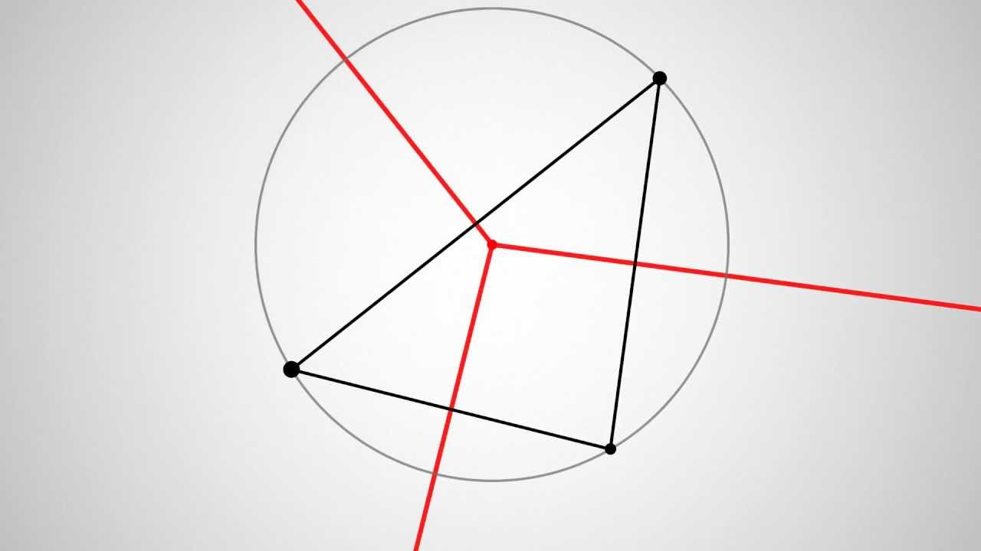
4 - Delaunay Triangulation
Boris Nikolaevich Delaunay (1890 – 1980)
The pattern of connections between Veronoi regions can be found using Delaunay triangulation
  The nodes (or generators) of the Voronoi diagram are the vertices of the Delaunay triangulation.
  Each triangle of the Delaunay triangulation is associated with one vertex of the Voronoi diagram.
  The vertex is located at the centre of the circumscribed circle.
  The circumcirle of each triangle is empty
Adds overhead to development
Can use Artist (Designer) to specify nodes
and automatically generate domains from these

Slide 16
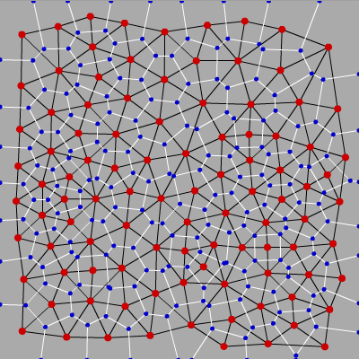
4 - Delaunay Triangulation

Slide 17
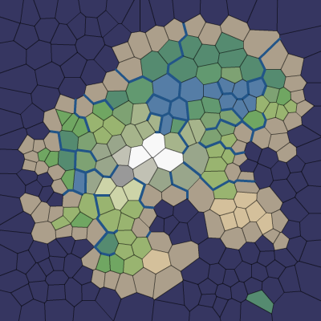
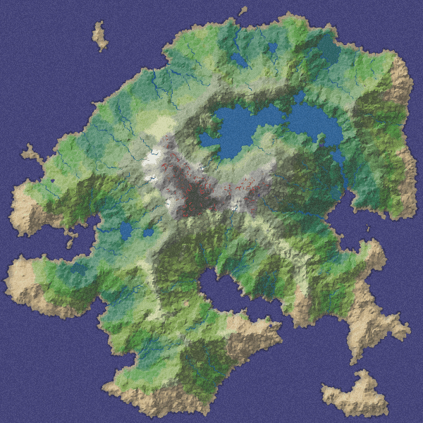
4 - Delaunay Triangulation
Example: Voronoi diagrams with Lloyd relaxation producing a nice set of polygons
http://simblob.blogspot.ie/2010/09/polygon-map-generation-part-2.html

Slide 18
4 - Dirichlet Domains
Quantization:
  Find closest point
  Searching through all points to find the closest is time consuming O(n)
  Use a partitioning algorithm (e.g. BSP) to only consider nearby points
Localization:
  Position of characteristic point of domain
Invalid graphs can be produced
  Pathfinding solution might not be feasible
    Intricate shapes can be designed, therefore traveling to two adjacent Dirichlet domains might in actuality lead through a third domain that is impassable
  but if we set points manually…
  Incorporate obstacle avoidance

Slide 19
4 - Dirichlet Domains
Usefulness:
  Widely used
  Easy to program (ish)
  Easy to change
  Pathfinding friendly

Slide 20
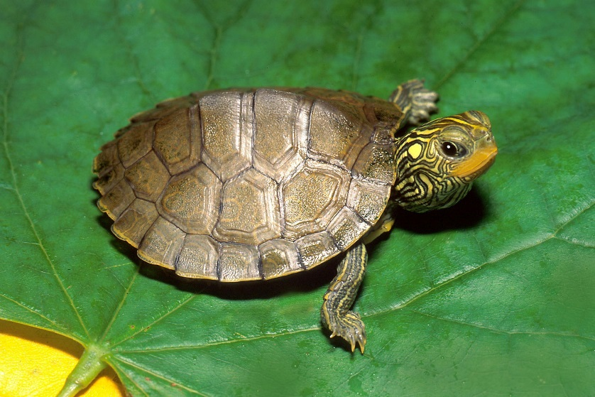
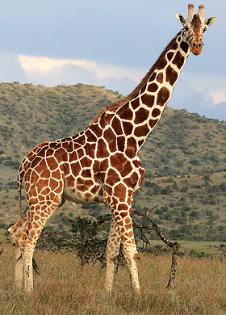

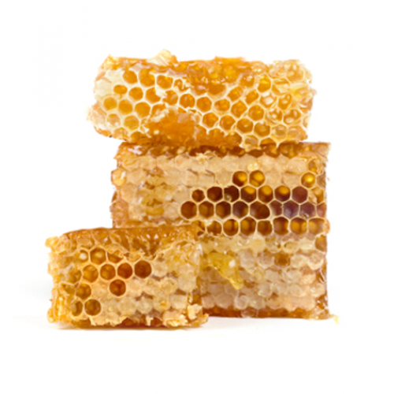
Veronoi is everywhere

Slide 21
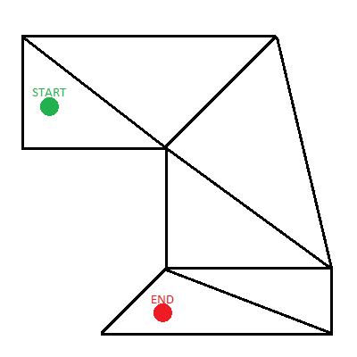
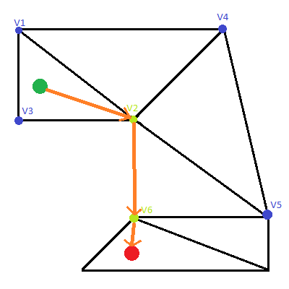
Putting it all together
End points normally somewhere within a triangle
  But which one? PointInsideTriangle()
    Both points are located on the same triangle
    One or both points are outside all triangles
    Both points are located on different triangles
Call A*
  All triangle vertices in the open list
  Finished when on one of vertices from goal triangle
  Straight line to goal
Game Development – A* on Triangulated Spaces
Javascript example
Notes:
https://codepen.io/PlainSight/pen/DmiGt/

Slide 22
Path Smoothing
Smooth paths look more natural!
Some graphs can be highly erratic
  NPC looks unintelligent
Could use steering behaviour to smooth the path
Otherwise adjust path with a smoothing algorithm
  Can be somewhat time consuming due to geometry checking

Slide 23
Path Smoothing
Tile based graphs can be especially erratic
Use straight lines when moving where possible
  where necessary (overhead of computing smooth paths)
Create new path from old as follows
  First node of new path is first node of old path
  Cast ray to each node in old path until LoS is not found
  Add last LoS node to new path
  Repeat process from new node.
Finds smoother path but not necessarily best smooth path. Why?
Notes:
To generate the smoothest path, we would need another search among all possible smoothest paths. This is rarely if ever necessary.

Slide 24
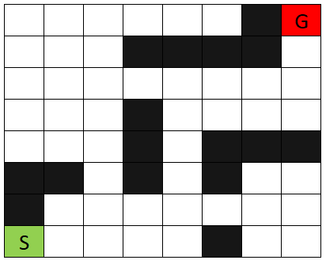
Path Smoothing

Slide 25
smoothPath(oldPath)
if length(oldPath) == 2: return oldPath
newPath.add(oldPath[0])
for (int i = 2; i < oldPath.length; i++):
  if NOT(LoS(newPath[length(newPath)-1], oldPath[i])):
    newPath.add(oldPath[i-1])
newPath.add(oldPath[length(oldPath)-1])
return newPath

Slide 26
smoothPath(oldPath)
if length(oldPath) == 2: return oldPath
newPath.add(oldPath[0])
for (int i = 2; i < oldPath.length; i++):
  if NOT(LoS(newPath[length(newPath)-1], oldPath[i])):
    newPath.add(oldPath[i-1])
newPath.add(oldPath[length(oldPath)-1])
return newPath
Expensive ray-casting .

